Slide 1
CREATING TROOP SECURED VIRTUAL BOOTH EVENTS (Troop Booth Links)
How to set up a virtual booth event and manage the orders

Slide 2
Troop Secured Virtual Booth Events

Slide 3
What’s a Virtual Booth Event and how does it work?

Slide 4
What is a Troop Secured Virtual Booth Event?
A Troop secured virtual booth event allows customers to order and pay for delicious Girl Scout cookies via credit card in advance of a pick up event to be held at a designated location on a
pre-determined date and time
Easy. Safe. Touchless transactions.

Slide 5
Here’s how it works – Troop experience
Troops will secure and set up a location, date and time where customers can pick up their cookie orders drive thru style!
The Troop volunteer sets up the event information in Smart Cookies and shares the Virtual Troop Booth link via email, text or social media
Consumers will access the Troop link from which they can make their cookie selections and pay for their order via credit card
Troop volunteers must approve all virtual booth event orders received
The customer is notified that their order has been approved for pickup and their credit card has been charged

Slide 6
Here’s how it works – Girl Experience
The Troop volunteer works with the Troop girls to review the approved orders to be packed and labeled for pickup
The Troop sets up their booth at the designated location on the planned date and time
Customers drive (or walk) up to the booth, show proof of ID and the order is placed on a table for pick up or is placed in the vehicle
NOTE: Please follow all GSUSA Safety Activity Checkpoints
The Troop credits the girls for the sales using the Smart Cookies Virtual Booth Divider

Slide 7
Things to consider…..
Safety is our number one priority when participating in cookie sale activities. Just as a traditional booth sale can help you reach customers that extend beyond friends and family, the virtual Troop secured booth sale can provide the same experience. Consider pick up locations that are safe and secure, well lit and allow for an easy flow of vehicle and/or foot traffic in well traveled areas
Consider how you’ll share your Virtual Troop Booth link. Home owners association websites, churches, businesses, social groups or locally planned event websites offer great opportunities to advertise a Girl Scout virtual booth sale event. Ask to participate in a planned event and provide your Troop Booth link to be advertised along with other event details
Your virtual booth link can be associated with a traditional booth sale allowing for pre-sales that you can have ready for pick up

Slide 8
Other options to carefully consider….
Your Troop Booth Link can be shared via email, text or social media. Requests for delivery of orders can be added as a option with your Troop Booth Link. Consider the use of social media and how far reaching the results may be. Social media posts can extend far beyond your reasonable delivery area which might generate orders that you would be unable to deliver if you are offering delivery as an option with your Troop link. Sending your link via Facebook messenger to specific contacts might be the better option
When delivery is activated, ALL currently posted pick-up locations will also show delivery as an option. You’ll want to use the delivery feature specifically for those orders that are within a reasonable distance for you. For example, a local business contact would like to purchase cookies for their employees through your Troop. You can create a virtual booth event for the business and enable the delivery feature. The business can place their order for delivery. Your Troop receives the credit which you can then transfer on to your Troop girls. You will be able to cancel any delivery request you do not want to fulfill

Slide 9
Troop Secured Virtual Booth Set-up

Slide 10
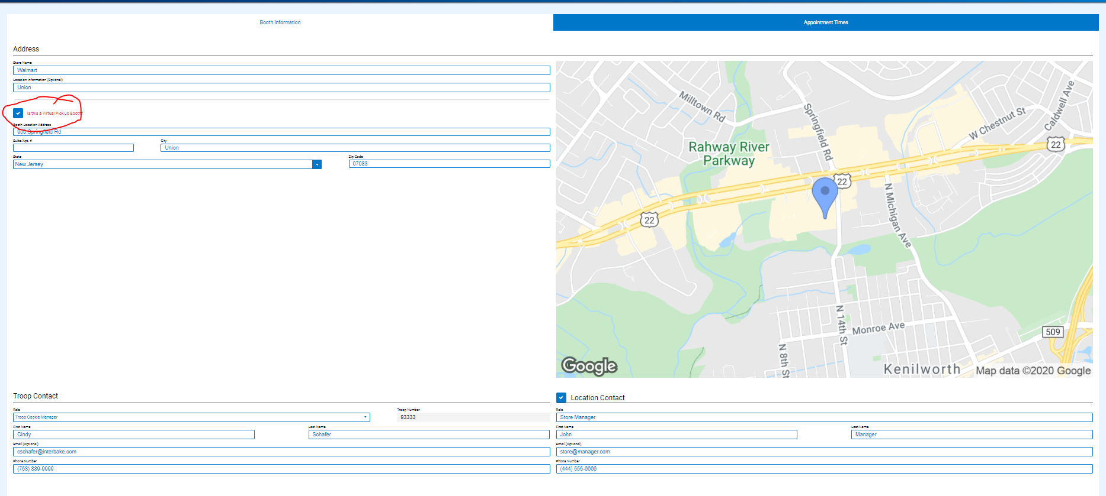
How to create the Troop Secured Virtual Booth Event
Notes:
Login to Smart Cookies and navigate to the Booth menu
Click on Troop Secured Booth
Complete the location information
Be sure to check the Is this a Virtual Pick up Booth? box
Click next at the bottom of the screen to enter the date/time of your event

Slide 11
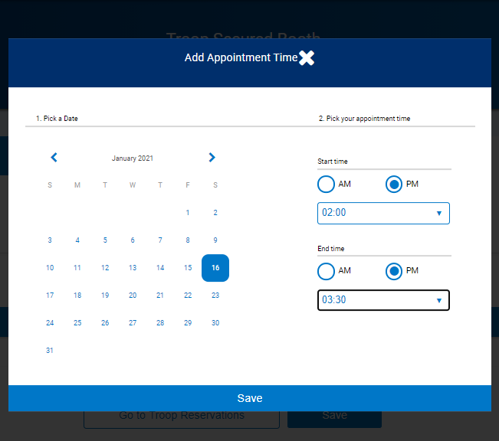
Add Event Date and Time
Notes:
Click on Add Appointment time
Select the date and enter the start and end time of the pick up event
Click Save
Click Save to complete the reservation
Unlike traditional Troop Secured Booth requests, Troop Secured Virtual Booth events do not require Council approval
Next step is to set up your start and end dates for accepting orders

Slide 12
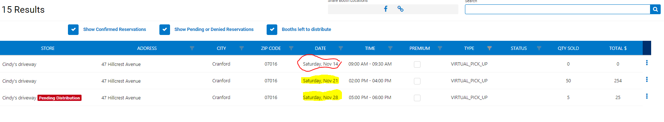
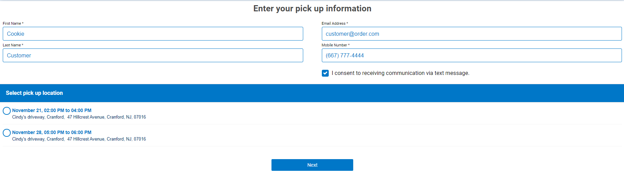
Creating Multiple Events
Multiple Virtual Booth Events created for the customer to select pick up from on 11/10/20
Customer view when clicking on the Troop Virtual Booth Sale link on 11/15/20
Notes:
You can create more than one event to have active at any time
If you have secured a pickup location for 2 weekends in a row – enter both dates and the times the pickups will take place for each
If you have multiple sites secured you can create a Troop secured virtual booth for each, we recommend keeping your actively displayed booths within 10-14 days ahead of the pick-up date
As your pick up dates pass, they will be dropped from the display on your virtual booth link

Slide 13
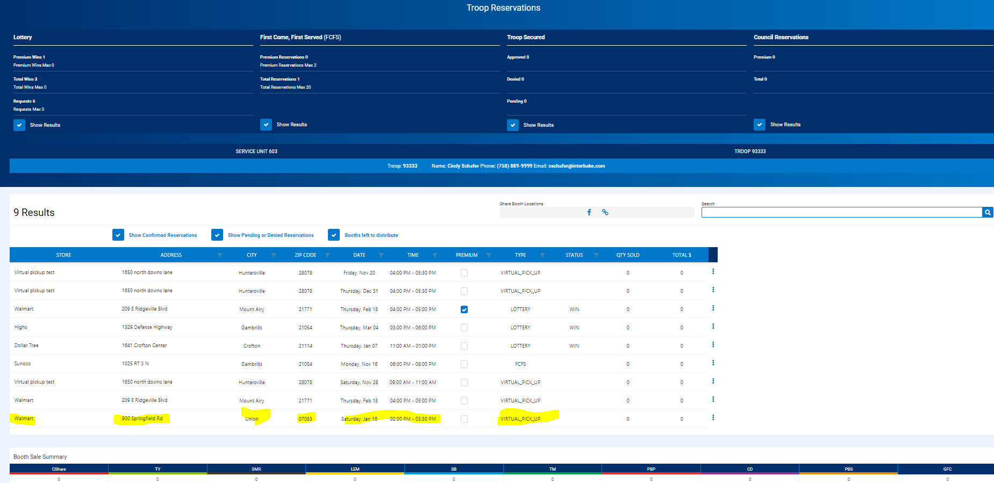
My Reservations
Notes:
Navigate to the Booth menu, select My Reservations to see the Virtual Pick Up event created
The orders that you approve for pickup at your event will be totaled by variety in this entry
You’ll use the Smart Virtual Booth Divider to give sales credit to the girls after the event

Slide 14
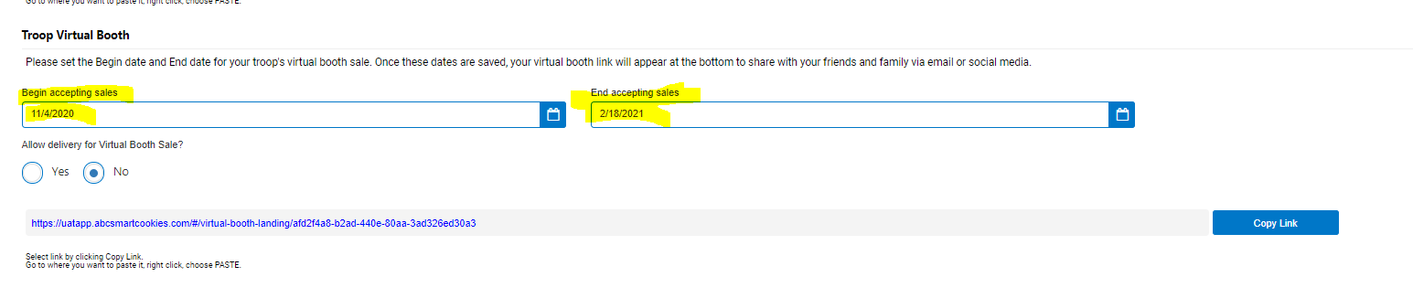
Setting up dates to accept orders
Orders via your Troop virtual booth link can only be placed between these dates. You may change these dates at any time
Reset the dates for each planned event
Notes:
Navigate to the My Troop menu
Select Troop information
Scroll to the bottom of the page to the Troop Virtual Booth section
Enter the date you want to start accepting orders for your Virtual Troop booth event
Enter the date you want to stop receiving orders for your Virtual Troop booth event
If you want to include accepting requests for delivery with your Virtual Troop booth link, check Yes

Slide 15
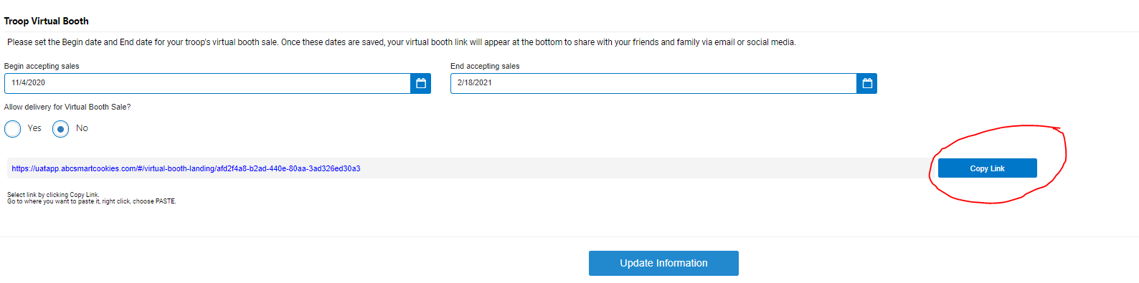
Share your Troop Virtual Booth Link
Email
Text
Social Media
Notes:
Copy and paste your Troop virtual booth link in the desired medium

Slide 16
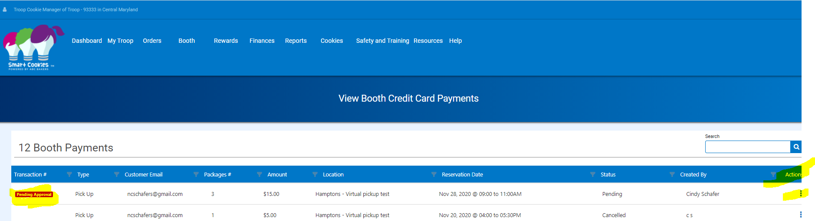
Review orders received
Click on the ellipsis under the Action button to open the order and review it
Notes:
Once your Troop Virtual Booth Link is shared and your start date for accepting orders is active, you will be able to see order requests
To view orders received, navigate to the Booth Menu and select View Booth Credit Card Payments
You will see order that are pending approval highlighted in red
Click on the menu ellipsis on the end of the order row to review the order
Click to approve fulfilling the order or cancel if you cannot fulfill your order
Customers have the option of donating their order if it cannot be fulfilled, if you cancel the order you will see the conversion to donation if that option was selected by the customer

Slide 17
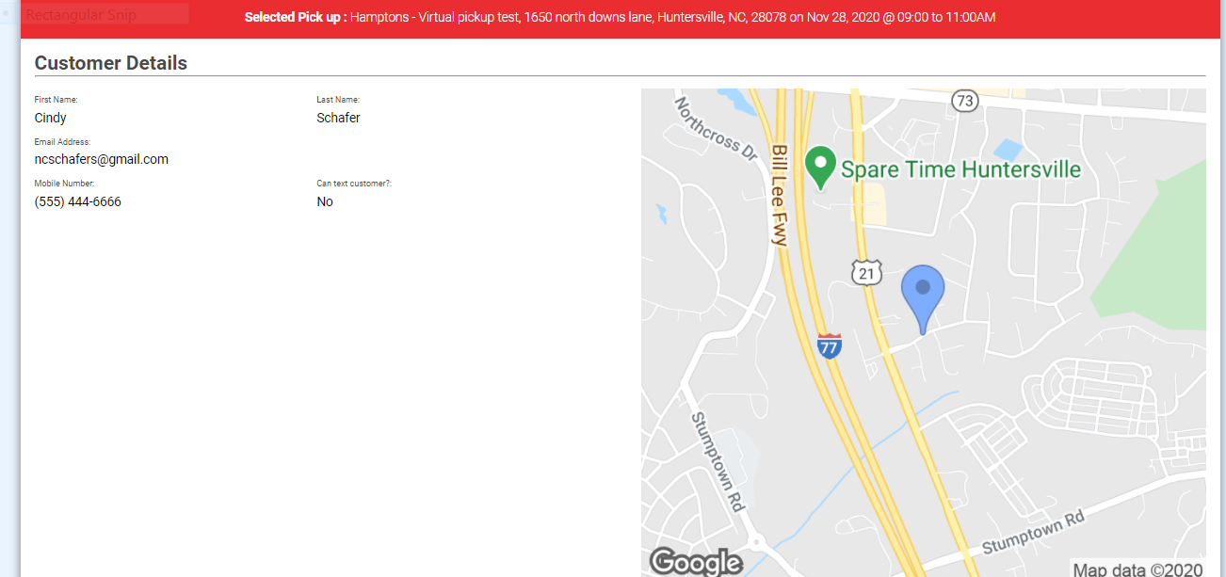
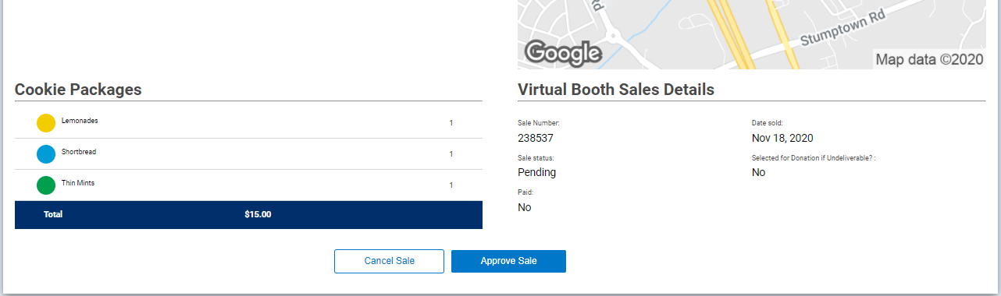
Approve or cancel the sale
Notes:
Note the pickup location and date at the top of the order
Note the customer information
Review the order requested
You’ll need to compile all of the orders for each individual pick up location to insure that you have inventory or can arrange to get additional information to fulfill your orders
Approved orders send an email to the customer advising them their sale will be ready for pick up at the designated place and time and that their credit card has been charged
Cancelled orders send an email to the customer advising them that their order cannot be fulfilled, their credit card has not been charged and provides a link to order via direct ship
When all orders have been approved or cancelled, you will run the Booth Sale Credit Card Transaction Report

Slide 18
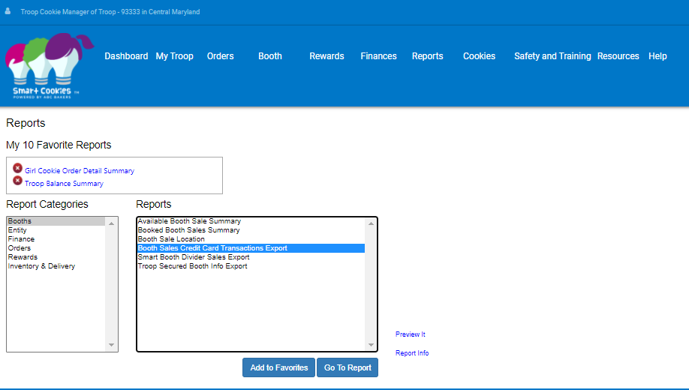
Order report – preparing your orders

Slide 19
Sort your orders by location and date
Type | Transaction# | CreatedUser | CustomerEmail | CustomerMobileNumber | CanTextCustomer? | Amount | Location | Address | ReservationDate | ReservationTimeSlot | Status | TimeStamp | CShare | TY | SMR | LEM | SB | TM | PBP | CD | PBS | GFC | Total
Pick Up |  | Chris McDaniel | customer@email.com | 8042398115 | No | 10 | Hamptons - Virtual pickup test | 1650 north downs lane, , Huntersville, NC, 28078 | 11/20/2020 12:00:00 AM | 04:00 PM to 05:30 PM | Approved & Paid | 10:14:32 | 0 | 2 | 0 | 0 | 0 | 2 | 0 | 0 | 0 | 0 | 4
Pick Up |  | c s | customer@email.com | 5555555555 | Yes | 20 | Hamptons - Virtual pickup test | 1650 north downs lane, , Huntersville, NC, 28078 | 11/20/2020 12:00:00 AM | 04:00 PM to 05:30 PM | Approved & Paid | 16:29:42 | 0 | 1 | 0 | 0 | 0 | 1 | 1 | 1 | 0 | 0 | 4
Pick Up |  | cindy schafer | customer@email.com | 8887776666 | No | 10 | Hamptons - Virtual pickup test | 1650 north downs lane, , Huntersville, NC, 28078 | 11/20/2020 12:00:00 AM | 04:00 PM to 05:30 PM | Approved & Paid | 16:27:35 | 0 | 0 | 2 | 0 | 0 | 0 | 0 | 0 | 0 | 0 | 2
Pick Up | 815750329 | Chris McDaniel | customer@email.com | 8042398115 | Yes | 15 | Hamptons - Virtual pickup test | 1650 north downs lane, , Huntersville, NC, 28078 | 11/20/2020 12:00:00 AM | 04:00 PM to 05:30 PM | Approved & Paid | 09:24:10 | 0 | 0 | 0 | 3 | 0 | 0 | 0 | 0 | 0 | 0 | 3
Pick Up | 815945475 | Chris McDaniel | customer@email.com | 8042398115 | Yes | 10 | Hamptons - Virtual pickup test | 1650 north downs lane, , Huntersville, NC, 28078 | 11/20/2020 12:00:00 AM | 04:00 PM to 05:30 PM | Approved & Paid | 10:41:58 | 0 | 1 | 0 | 0 | 0 | 1 | 0 | 0 | 0 | 0 | 2
Pick Up | 816737887 | Cindy Schafer | customer@email.com | 9083477081 | Yes | 75 | Hamptons - Virtual pickup test | 1650 north downs lane, , Huntersville, NC, 28078 | 11/20/2020 12:00:00 AM | 04:00 PM to 05:30 PM | Approved & Paid | 13:08:31 | 0 | 3 | 0 | 3 | 0 | 3 | 3 | 3 | 0 | 0 | 15
Pick Up | 854460452 | Cindy Regression | customer@email.com | 9083477081 | No | 20 | Hamptons - Virtual pickup test | 1650 north downs lane, , Huntersville, NC, 28078 | 11/20/2020 12:00:00 AM | 04:00 PM to 05:30 PM | Approved & Paid | 01:12:51 | 2 | 0 | 0 | 0 | 0 | 2 | 0 | 0 | 0 | 0 | 4
Report provides the detail on each order that needs to be filled
Use this report to work with your Troop girls to fulfill each order
Label and tag each order to make the easily identifiable and ready for pick-up

Slide 20
Managing order pick-up day!
Load your pre-packed and labeled orders into your car
Set up at your pick up location 10 minutes before pickups start. Be sure to have signage visible for customer to locate you.
Orders will have been paid for when approved for pick up, no cash is needed for this event if you are just fulfilling preplaced orders
Set your orders up so that you can find them easily as customers pull up in their vehicles or walk up
The email order confirmation the customer receives advises them to bring ID or a copy of their order confirmation to identify themselves
Check the ID and have the order available for the customer to pick up, or place the order in the customer’s car if you are having curbside pick-up.

Slide 21
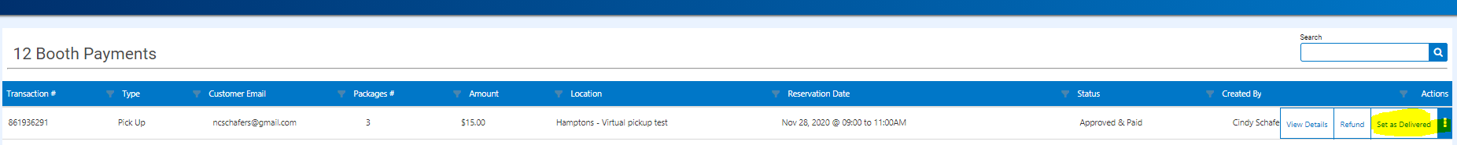
Marking orders as delivered
Return to the Booth Menu and View Booth Credit Card Payments
Locate the order, click the ellipsis under the Action heading and click on Set as Delivered
The customer will receive an email confirming the order has been delivered
The order status will change to delivered on the View Booth Credit Card Payments page

Slide 22
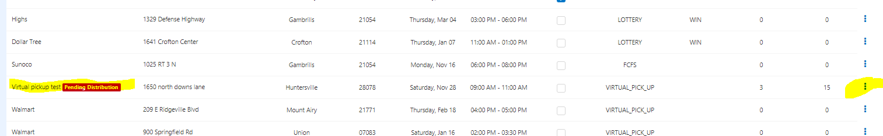
Crediting girls for Troop virtual booth sales
Navigate to My Reservations, Booth events needing to be distributed will be highlighted
Click on the menu under the action header
Notes:
Navigate to the My Reservations booth menu option
Booth events that have not been credited to girls will be highlighted
Delivery virtual booth orders will be combined in one entry to be divided among Troop girls
The orders obtained through each virtual pick up event with be tallied together and divided among Troop girls

Slide 23
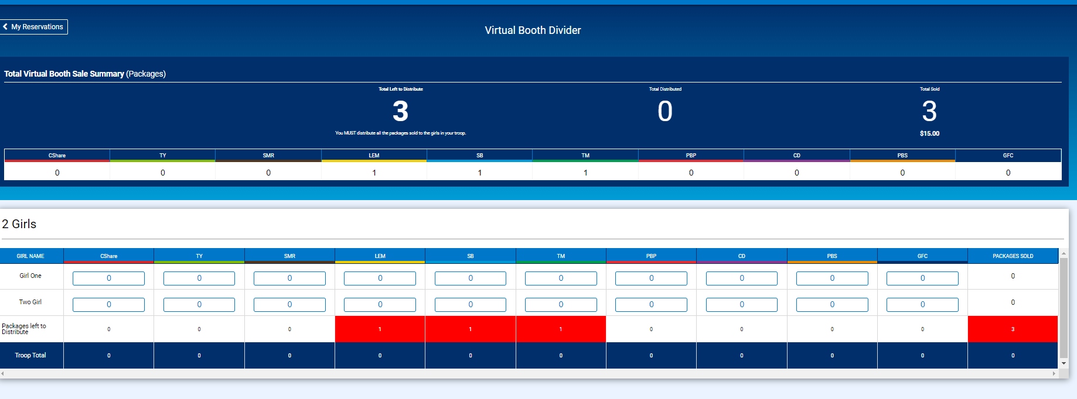
Transfer credit to girls
Notes:
Use the Virtual Booth Divider to distribute credit for the virtual booth event to the girl in your Troop

